Slide 1




GROUP 13
INTERNET PROGRAMMING AND MOBILE PROGRAMMING
REQUIREMENT GATHERING
DR NKEMENI VALERY

Slide 2
YOUR LOGO ABOUT PROJECT PRICE TEAM
TABLE OF CONTENTS
01
INTRODUCTION
02
STAKEHOLDER IDENTIFICATION
.
03
REQUIREMENT GATHERING TECHNIQUES
04
REQUIREMENT CONSTRAINTS

Slide 3

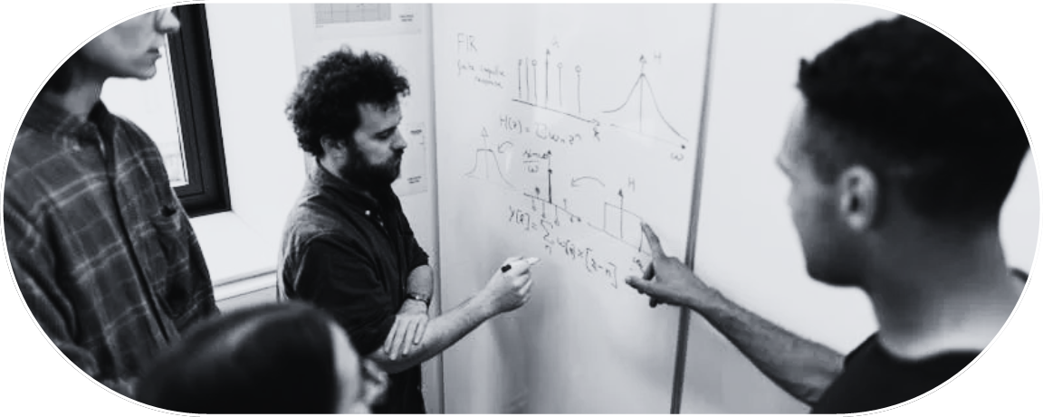

YOUR LOGO ABOUT PROJECT PRICE TEAM
Project Scope
Scope Statement
Deliverables
The objective of our biometric student attendance mobile application is to streamline the process of tracking student attendance in the University of Buea.
It has been by many lecturers that one of the measure reason why students in the University of Buea fail their courses is because of very poor class attendance.
YOUR LOGO ABOUT PROJECT PRICE TEAM

Slide 4

REQUIREMENT GATHERING
Requirement gathering is the process of collecting, documenting and analyzing the needs, expectations and specifications of stakeholders for a particular project or system.
DR NKEMENI VALERY

Slide 5



STAKEHOLDER IDENTIFICATION
DEFINITION
KEY STAKEHOLDERS
Student
Instructor
Administrator

Slide 6
STAKEHOLDER IDENTIFICATION
IMPORTANCE OF INVOLVING THEM IN THE REQUIREMENT GATHERING PROCESS
- Understanding Needs
- Building support
- Identify Risks
- Validating Assumptions

Slide 7


YOUR LOGO ABOUT PROJECT PRICE TEAM
REQUIREMENT GATHERING TECHNIQUES
Interviews
One to one interviews where conducted with key stakeholders of our platform such as Students, Instructors and Administrative staff.
Brainstorming
Here we tried to generate a large number of ideas, solutions between us the team developers.
Online Surveys
Google sheets forms where written so as to ease the work of send to other stakeholders.

Slide 8
YOUR LOGO ABOUT PROJECT PRICE TEAM
REQUIREMENT GATHERING TECHNIQUES
Document Analysis
Document analysis is a research method used to examine and interpret written or recorded information to gain insights and understanding about a particular topic
Observations
Here we try to look at how the current attendance is taken in different environments like and try to depict the tress that the parties involved many have

Slide 9
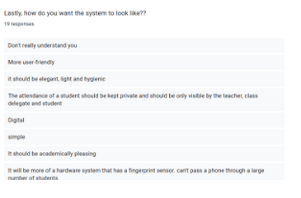
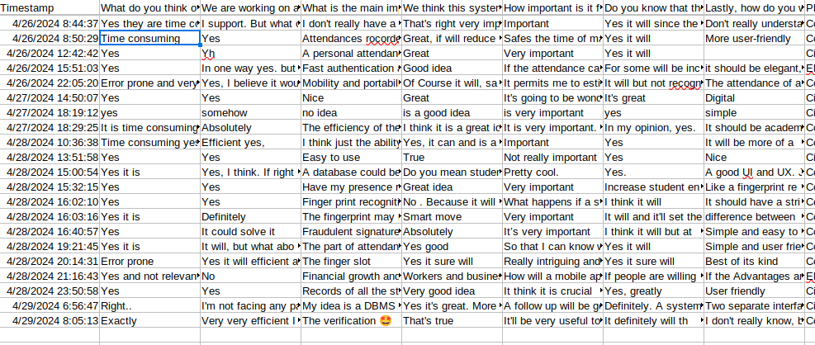
YOUR LOGO ABOUT PROJECT PRICE TEAM
REQUIREMENT GATHERING RESULTS
From the online surveys

Slide 10
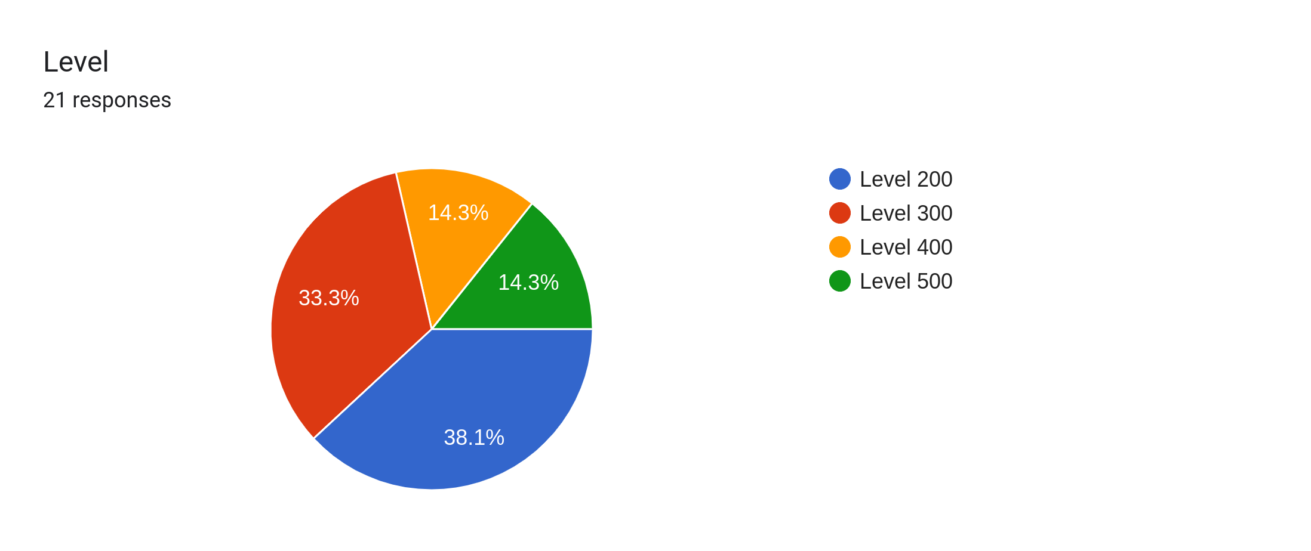
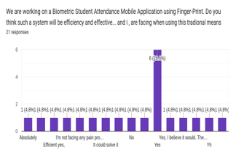
YOUR LOGO ABOUT PROJECT PRICE TEAM
REQUIREMENT GATHERING RESULTS
DATA VISUALISATION

Slide 11


YOUR LOGO ABOUT PROJECT PRICE TEAM
RESULTS FROM ONLINE SURVEYS
ATTENDANCE PERCENTAGE NOTIFICATION
ATTENDANCE REPORTS
PORTABILITY

Slide 12

YOUR LOGO ABOUT PROJECT PRICE TEAM
RESULTS FROM ONLINE SURVEYS
EFFICIENCY
EASE TO USE
PERFORMANCE

Slide 13

YOUR LOGO ABOUT PROJECT PRICE TEAM
RESULTS FROM BRAINSTRMING
ATTENDANCE EXCEPTION
ATTENDANCE BACKUP
NOTIFICATION

Slide 14
YOUR LOGO ABOUT PROJECT PRICE TEAM
RESULTS FROM DOCUMENT ANALYSIS
COMPATIBILITY
REAL-TIME ATTENDANCE
SCALABILITY

Slide 15



YOUR LOGO ABOUT PROJECT PRICE TEAM
RESULTS FROM INTERVIEWS(INSTRUCTORS)
ATTENDACE SESSION TAKING
REGISTRATION AND LOGIN PROCESS
GENERATE ATTENDANCE REDORDS
TIME FRAME

Slide 16
YOUR LOGO ABOUT PROJECT PRICE TEAM
RESULTS FROM INTERVIEWS(ADMINISTRATOR)
ATTENDACE SUMMARY
MONITORING
INSTRUCTORS
CLIENT SERVER APPLICATION
FINGERPRINT ENROLLMENT

Slide 17
YOUR LOGO ABOUT PROJECT PRICE TEAM
RESULTS FROM INTERVIEWS(STUDENTS)
ATTENDANCE PERCENTAGE NOTIFICATION
INTERFACE CUSTOMIZATION
ATTENDANCE REPORT
USABILITY

Slide 18

REQUIREMENT CONSTAINTS
- BUDGET
- TIME FRAME
- REGULATORY COMPLIANCE

Slide 19
REQUIREMENT LIMITATIONS
- ACCESSIBILITY
- ENVIRONMENTAL FACTORS

Slide 20
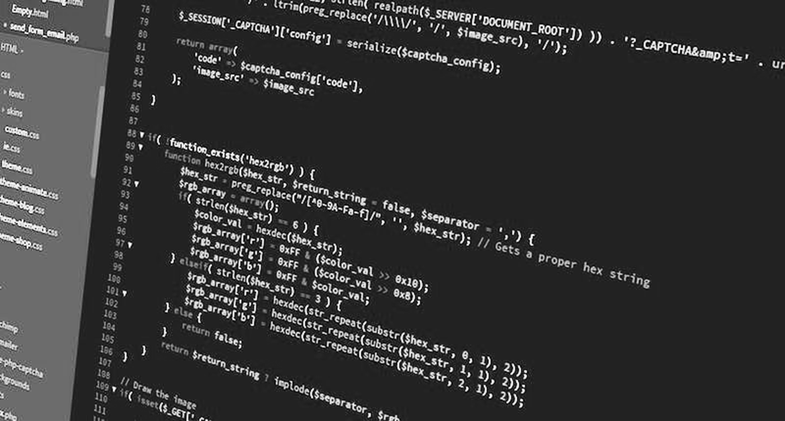
No matter how good the team or how efficient the methodology, if we’re not solving the right problem, the project fails
— Woody Williams

Slide 21
THANK YOU FOR
KEEN YOUR ATTENTION

